Slide 1
A Client-Side Evil-Twin Attack Detection System with Threshold Considering Traffic Load
Tomoyuki Ueda, Sumiko Miyata
† Amgad Saif
† † Masataka Nakahara, † † Ayumu Kubota
Shibaura Institute of Technology
† KTH Royal Institute of Technology
† † KDDI Research
These research results were obtained from the commissioned research(No.05201) by National Institute of Information and Communications Technology (NICT) , Japan.
Notes:
I will be presenting my research titled ”A Client-Side Evil-Twin Attack Detection System with Threshold Considering Traffic Load”

Slide 2
Research background and objectives
Increase in access points (APs) following the Corona disaster in recent years.
Increased damage caused by rogue APs
➡ Evil Twin Attack
[S. Kitisriworapan +, EURASIP Journal on Wireless Communications and Networking, 2020]
[K. C. Patel+, INDIACom, 2022]
Improved accuracy of rogue AP detection
Notes:
In recent years, the number of access points (APs), commonly known as Free-WiFi, in wireless LANs has been increasing.
Additionally, with the COVID-19 pandemic, remote learning and work have become more prevalent, leading to an increase in people working remotely at cafes and restaurants. As a result, the number of APs is expected to continue to rise.
However, alongside this growth, there has been an increase in attacks known as rogue APs, such as evil-twin attacks.
Therefore, there is a demand for improving the accuracy of detecting rogue APs.

Slide 3



Research background and objectives
Evil Twin Attack
To spoof legal wireless LAN APs and launch various attacks against connected users.
[En-Chun Kuo+, IEEE ICACT, 2018]
SSID : Free-1
SSID : Free-1
Rogue AP
？
Legal AP
User
Notes:
Evil-Twin attack is a type of attack where the attacker impersonates a legal wireless LAN access point (AP) and launches various attacks against connected users.
In the example below, the rogue AP is configured with the name "Free-1," which is the same as the SSID of the legal AP.
The intention is to confuse users and trick them into connecting to the rogue AP, through which the attacker can steal personal information or deliver malware.

Slide 4
Conventional Methods
Classification of existing methods
Fingerprint (Administrator's side)
➡ Stable accuracy, High cost, Great hassle
[Qiaolin+, IEEE Transactions on Vehicular Technology, 2021]
RTT : Round trip time (User side)
➡ Low cost, Less hassle, Affected by the environment [Kitisriworapan+, J Wireless Com Network, 2020]
Proposal for detection in these hybrids
Notes:
Next, let's introduce the existing methods. Existing methods are mainly divided into two categories: those focused on detection from the administrator's side and those focused on detection from the user's side.
One of the typical methods from the administrator's side is using fingerprints. The advantage of this method is its stable detection accuracy, but the drawback is the significant cost and effort required for implementation.
On the other hand, one of the representative methods from the user's side is using Round-Trip Time (RTT). The benefit of this approach is its relatively low cost and ease of implementation, but it can be more susceptible to environmental influences.
In light of these findings, we propose a detection method that combines both RTT and fingerprinting techniques.
By integrating the advantages of both approaches, we aim to enhance the accuracy and robustness of the detection process.

Slide 5


Conventional methods
RTT-based detection methods
Use RTT differences between different hop counts.
Detection by comparing the difference between the threshold and the RTT.
Use k-means clustering on RTT data in detection.
[Kitisriworapan+, J Wireless Com Network 2020]
2-hop
Rogue AP
（evil-twin）
User
1-hop
Legal AP
Internet
Notes:
Let me explain the detection method using RTT. Typically, the relationship between the user, legal AP, and rogue AP is as depicted in the diagram below.
When connected to the legal AP, there is 1-hop. However, when connected to the rogue AP, there are 2-hops. As a result, the RTT tends to be longer for the two-hop scenario due to the processing and transmission time at the rogue AP.
In RTT-based detection, a threshold for RTT is determined, and if the RTT exceeds this threshold, it is considered as an indication of the presence of a rogue AP.

Slide 6
Conventional methods and issues
RTT-based detection methods
RTT dispersion during congestion less considered
Improved detection accuracy by considering
Methods using MCS (transmission rate)
MCS： Modulation and Coding Scheme
Getting MCS is not easy for ordinary people
[Kitisriworapan+，J Wireless Com Network 2020]
Evil-Twin detection considering traffic load
Notes:
As mentioned earlier, the RTT-based detection method is susceptible to environmental influences, especially during times of traffic congestion, where the consideration of RTT dispersion is limited. The increased dispersion can lead to false detections.
Indeed, some methods have utilized the MCS index, which includes settings related to modulation and coding.
However, obtaining the MCS values is not straightforward for the general public.
Therefore, we focus on developing a new Evil-Twin detection method that takes traffic load into account.

Slide 7



Key idea
Detection with separate traffic load
Get traffic load in AP and send to server
Sever send suitable threshold for current traffic load to user
Receive thresholds tailored to the load.
control server
PC
AP
Get RTT sending ping to google.com
devices
google.com
Notes:
The key idea is to perform detection for each traffic load. The experiment was conducted with four different loads using Iperf and several devices.
We applied load between two PCs using Iperf while simultaneously sending pings to Google to measure the RTT.
The detailed experimental procedure will be explained later.

Slide 8
Key idea
Detection with separate traffic load
User measures RTT and compares RTT and received threshold
If RTT is greater, then there is a rogue AP
Receive thresholds tailored to the load.
control server
PC
AP
Get RTT sending ping to google.com
devices
google.com
Notes:
The key idea is to perform detection for each traffic load. The experiment was conducted with four different loads using Iperf and several devices.
We applied load between two PCs using Iperf while simultaneously sending pings to Google to measure the RTT.
The detailed experimental procedure will be explained later.

Slide 9
Experiment flow
Measure RTT
Get RTT
AP
Thresholds are assigned for each traffic load
User
Detect with k-means
”There is rogue AP”
RTT [ms]
Yes
No
Use CDF
Done
Data number

Slide 10
Detection method (1)
Using the k-means method
Measured RTT data is divided to two groups
Applies to normal/attack data
Find the y-axis ratio of the centroid coordinates
y-axis ratio
Get RTT
AP
RTT [ms]
User
Number of packets
Notes:
Next, let me explain the detection method. We use the k-means algorithm for detection.
The k-means algorithm is a clustering method that groups data into clusters.
In our case, we use two clusters, and we calculate the y-axis ratio of the coordinates of each cluster's centroid.
This y-axis ratio is then computed separately for the RTT data under normal conditions and the RTT data during an attack.

Slide 11
Detection method (2)
Calculate y-axis ratio from normal data ➡ Threshold value
Legal AP
The y-axis ratio calculated from the normal data
Rougue AP
The y-axis ratio calculated from the attack data
RTT [ms]
Data number
Greater than threshold
➡There is rogue AP
RTT [ms]
Data number
Notes:
Then, for each of the four traffic load conditions, we follow these steps.
The threshold for the y-axis ratio will be determined using one data point from the normal RTT data set.
Then, the y-axis ratio will be calculated for the remaining normal RTT data and the attack RTT data.
By comparing these calculated values with the threshold, if exceed the threshold, it will be concluded that a rogue AP is present.

Slide 12
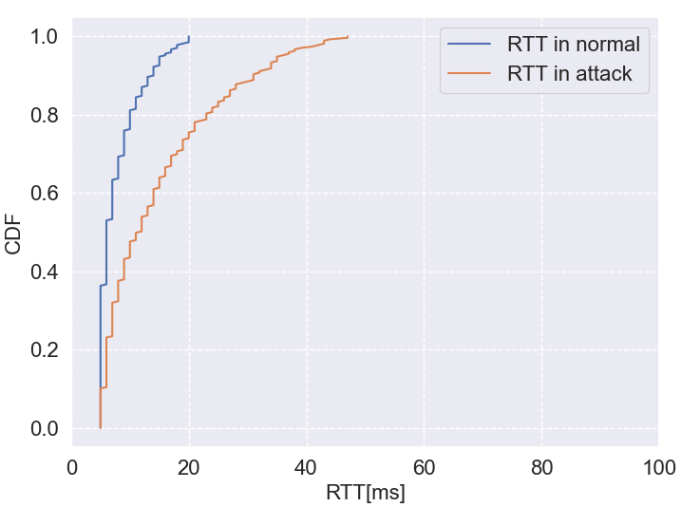
Detection method (3)
CDF : Cumulative Distribution Function
Additional detection using CDF
Compare confidence intervals and the avarage of RTT
[Kitisriworapan+, J Wireless Com Network 2020]
Notes:
To prevent false detections, an additional detection method is employed using the cumulative distribution function, commonly known as CDF.
CDF is a function that represents the probability of a random variable being less than or equal to a certain value. In this case, it refers to CDFs that show the probability of taking a value less than or equal to a certain RTT.
Even if the k-means based detection does not identify a rogue AP, when the confidence interval of the CDF is compared with the average RTT. And if the average RTT is outside the range of the CDF, it is taken as an indication of the presence of a rogue AP.

Slide 13
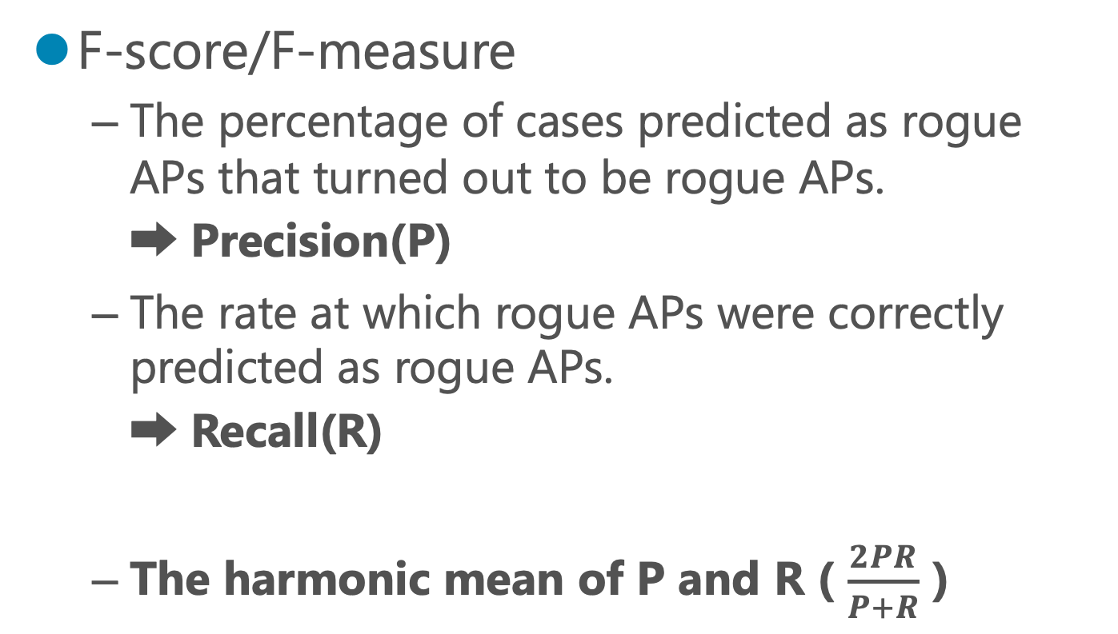
Evaluation method
F-score/F-measure
The percentage of cases predicted as rogue APs that turned out to be rogue APs.
➡ Precision(P)
The rate at which rogue APs were correctly predicted as rogue APs.
➡ Recall(R)
The harmonic mean of P and R ( $\frac{2PR}{P+R}$ )
Notes:
The evaluation is done by F-score.
F-score is The harmonic mean of P and R.
Where P is the percentage of cases predicted as rogue APs that turned out to be rogue aps and R is The rate at which rogue APs were correctly predicted as rogue APs.

Slide 14


Experimental environment
Detection with separate traffic load
Experiments in the 2.4GHz band
Without Iperf and 3MB, 5MB and 7MB load
Load using iperf
between PC1 to PC2
PC 2
Send ping
PC1 to google.com
PC 1
(To measure)
Rogue AP
Legal AP
Devices
16 IoT devices
google.com
Notes:
Next, I discuss the experimental setup in more detail.
As mentioned earlier, we conducted the experiments using Iperf between two PCs while sending pings to google.com to measure the RTT until the ping response is received.
During the experiments, the devices connected to the AP included 3 PCs, 1 smartphone, and 16 IoT devices, and the operating frequency was set to 2.4GHz.
We performed the experiments under four traffic load conditions: no Iperf load, Iperf load of 3MB, Iperf load of 5MB, and Iperf load of 7MB.
次に、実験方法について詳しい話をします。 先ほども話した通り、2つのpc間でiperfを使い、その状態でgoogle.comにpingを打ち、pingが返ってくるまでの時間をRTTとして実験をします。 この時、APに接続しているデバイスは、3つのPCと1つのスマートフォン、16個のIoT機器であり、使用している帯域は2.4GHZで行った。 また4つのトラヒックの状態は、iperfなしの状態とiperfで3MBの負荷、5MBの負荷、7MBの負荷の状態の4つである。

Slide 15
Proposed and comparison methods
Proposed methods
Assume 4 types of traffic load situation
Calculation of thresholds by traffic load
With CDF
Comparison method
Only one type of threshold is fixed
Thresholds determined in an environment without varied load
Without CDF
Notes:
The competing method, as described earlier, adopts a single threshold for detection, regardless of the traffic load state.
Unlike the proposed method, which sets different thresholds for the four traffic load conditions, the comparison method relies on a single threshold to determine if an Evil-Twin attack is present.

Slide 16
Detection results (proposed method)
F-score : 0.92, Accuracy : 0.92
Four measurements with 300 packets per measurement
1 time used for training data, 3 times for test data
 | Not using iperf |  |  | Iperf 3MB |  |  | Iperf 5MB |  |  | Iperf 7MB
Legal | 〇 | 〇 | 〇 | 〇 | 〇 | 〇 | 〇 | 〇 | 〇 | × | 〇 | ×
Rogue | 〇 | 〇 | 〇 | 〇 | 〇 | 〇 | 〇 | 〇 | 〇 | 〇 | 〇 | 〇
Notes:
In this experiment, the number of RTT data used in one experiment was 300; four measurements were made, one of which was used as the threshold.
First, let's start with the results of the proposed method.
This resulted in an F-score of 0.92 and a percentage of accuracy of 0.92.
１回の実験で使用されたRTTデータ数は300である。4回測定し、そのうち1回を閾値に利用した。

Slide 17
Detection results (comparison method)
F-score : 0.74, Accuracy : 0.79
Only one type of threshold is fixed
Detection at threshold without Iperf
Without CDF
 | Not using iperf |  |  | Iperf 3MB |  |  | Iperf 5MB |  |  | Iperf 7MB
Legal | 〇 | 〇 | 〇 | 〇 | 〇 | × | × | 〇 | 〇 | × | × | ×
Rogue | 〇 | 〇 | 〇 | 〇 | 〇 | 〇 | 〇 | 〇 | 〇 | 〇 | 〇 | 〇
Notes:
In this method, as mentioned earlier, the comparison method uses a single threshold. That is from the y-axis ratio calculated from the results when Iperf is not used.
This resulted in an F-score of 0.74 and a percentage of Accuracy of 0.79.
先ほども言ったように、使う閾値は一つのみで、iperfを使用しない時の結果から算出したy軸比を閾値としています。

Slide 18
Summary and tasks
Evil-Twin detection using RTT
RTT changes depending on traffic load
Conventional methods may create detection errors
Proposal for a traffic load-aware detection method using the k-means method
Improved F-score compared to not considered
Detection in the 5GHz band
Notes:
In this study, we conducted Evil-Twin detection using RTT. Existing methods often did not consider the impact of traffic load on RTT variations. Therefore, we performed detection with varying thresholds for each traffic load condition. As a result, the F-score and accuracy improved compared to not considering traffic load. For future work, we plan to extend our detection method to the 5GHz band and investigate its effectiveness.
That concludes my presentation. Thank you very much.

Slide 19
View of detection results
Legal low
If the system decides Legal, we fill in a circle. If the system decides Rogue, we fill in a cross.
Rogue low
If the system decides Legal, we fill in a cross. If the system decides Rogue, we fill in a circle.
※Example of conventional method
 | Not using iperf |  |  | Iperf 3MB |  |  | Iperf 5MB |  |  | Iperf 7MB
Legal | 〇 | 〇 | 〇 | 〇 | 〇 | × | × | 〇 | 〇 | × | × | ×
Rogue | 〇 | 〇 | 〇 | 〇 | 〇 | 〇 | 〇 | 〇 | 〇 | 〇 | 〇 | 〇
Notes:
In this method, as mentioned earlier, the comparison method uses a single threshold. That is from the y-axis ratio calculated from the results when Iperf is not used.
This resulted in an F-score of 0.74 and a percentage of Accuracy of 0.79.
先ほども言ったように、使う閾値は一つのみで、iperfを使用しない時の結果から算出したy軸比を閾値としています。

Slide 20
Acquisition Result
Without iperf, connect with 3 PCs and an iPhone.
Notes:
This is the result when done without iperf.
We can see defference of RTT between normal and attack crearly.

Slide 21
Acquisition Result
Load 3MB, connect with 3 PCs and an iPhone.
Notes:
This is the result of a 3 MB load on iperf.

Slide 22
Acquisition Result
Load 5MB, connect with 3 PCs and an iPhone.
Notes:
This is the result of a 5 MB load on iperf.
It can be seen that the dispersion is gradually increasing.

Slide 23
Acquisition Result
Load 7MB, connect with 3 PCs and an iPhone.
Notes:
Hoever, in 7MB load on iperf, we can see
Threshold values are set for each of these RTT data for detection.

Slide 24
Average and variance of RTT
Without Iperf
3MB
Both Average and variance of RTT are legal<rogue
RTT increases as load increases
Aply detection programs to these data
 | Legal | Rogue
variance | 60.28 | 558.66
average | 9.76 | 20.25
 | Legal | Rogue
variance | 93.30 | 1533.75
average | 11.27 | 35.25
<
<
<
<
5MB
7MB
 | Legal | Rogue
variance | 501.21 | 2105.33
average | 14.47 | 42.54
 | Legal | Rogue
variance | 235.86 | 4069.70
average | 15.340 | 57.71
<
<
<
<
Notes:
This is the mean and variance in each pattern.
All means and variances are greater during attacks than during normal times.
And it can be seen that both the mean and variance increase as the load increases.
Detection is carried out on these data as described earlier. The detection results are shown next.

